Slide 2
Plan
Major Component Selection / Requirements
Circuit Protection / High Level Schematic
Safety Third (E-Stop)
Heat Calcs / Cooling
Detailed Power Distro and Terminals
Layout

Slide 3
Major Component Selection / Requirements
Power Supplies
Requirement: 25A at 72VDC
Why? Steppers need 72VDC 5A each (Four required, fifth planned spare)
Planning on 3x 24VDC power supplies in series
PSP-600-24 good price per amp and not too inefficient
Requirement: 5A + 3A at 24VDC
Why? Controller needs 2 separate 24VDC 3A power supplies (Logic and IO separate)
Why? 24VDC relay to turn on/off air solenoid from output (2 relays 1A each at 24VDC should be plenty)
Planning on 2x 24VDC power supplies (one for IO and one for Logic+Relays)
EDR-150-24 is 6.5A, so plenty of current and cost different up from 4A only $1

Slide 4
Circuit Protection / High Level Schematic
30A house breaker (10 awg) 240V
Disconnect (32A)
466150
10
10
10
14
Spindle VFD
3 hp spindle (9.6 FLA)
15A breaker
2907662
faz-d15-2-na-l
6-16A breaker
(10A 2907591
faz-c10-2-na-l)
24V 6A Power Supply
18
Control Power (3A CB x2) gmcb-1c-3
14
24V 6A Power Supply
Input Power (3A CB) gmcb-1c-3
10-16A breaker
(15A 2907594
16A GMCBU-2C-16)
24V 25A Power Supply
10
Stepper Drives (72V)
USCC1 for CC fuses
Class G fuse terminal blocks
1044423 with jumper
6A FUSE
14 / 10?
24V 25A Power Supply
24V 25A Power Supply

Slide 5
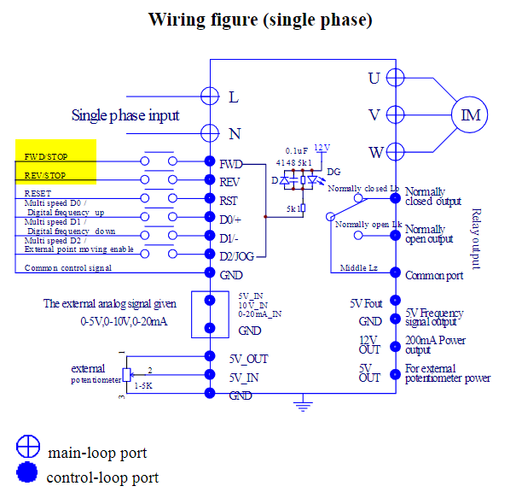
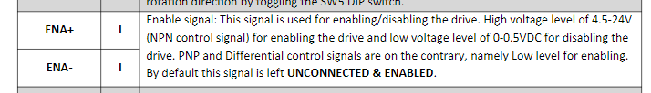
Safety Third (E-Stop)
Controller EStop is software (does not have an estop output), so you don’t directly know when it's buttons are pressed
What should estop do?
Stop spindle, stop servos
Remote estop input for controller
VFD has estop input
Big power supplies have a jumper that you can remove to turn them off

Slide 6
Heat Calcs / Cooling
Max temp things are okay with:
VFD: 40C
Power supplies: 60C
Drives: 50C
Summary
620W of heat to dissipate
600x600x300 cabinet (dissipates ~65W, calc has a 250mm depth cabinet)
Assumption: Max internal temp 40C, max external temp 30C, altitude 250-499m, Single enclosure, free-standing on all sides
Necessary air throughput: 185 m3/h

Slide 7
Detailed Power Distro and Terminals

Slide 8
Layout
Y2
Y1
Y2 0
Y1 0
prox
slot
Y+
X0
X
Z
Y-
X-
Z0
X+
Z+
Z-
Y
X

